Slide 1
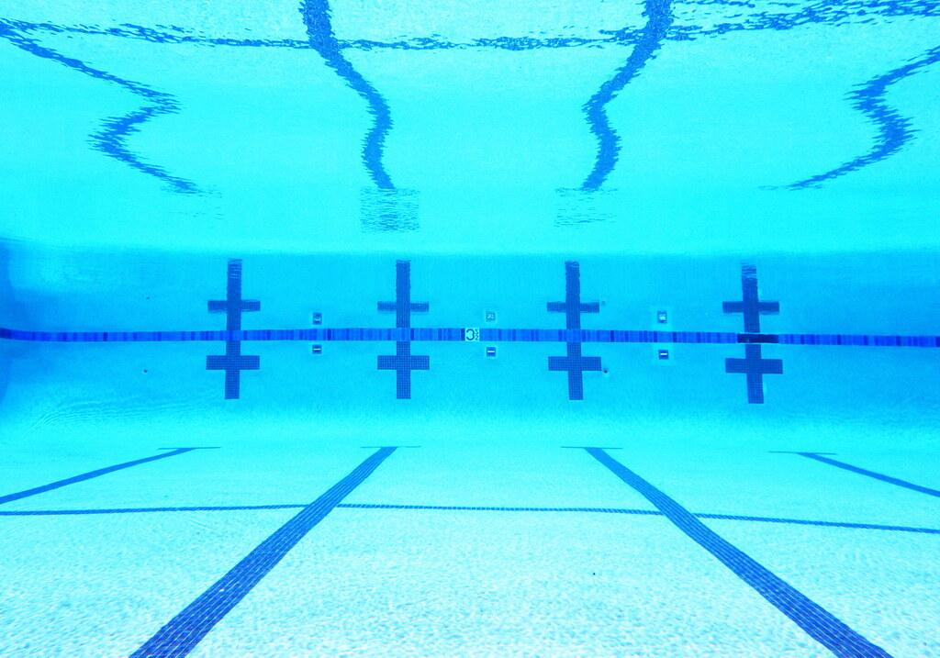
Pace
Parent Meeting
August 23, 2022

Slide 2
We’re glad you’re here!
We are a year round swim club that is affiliated with USA Swimming.
What does this mean?
We have 2 seasons - but run all year long!
Our Fall/Winter season runs from August to March.
Meets typically begin in October
Championship meets take place in March
Our Spring/Summer season runs from April through July.
This season is swam Long Course - meaning swimmers swim 50 meters
Meets typically begin in May
Championship meets take place in July.
We DO encourage swimmers to participate with their summer league teams. Many of our swimmers participate on both teams in the summer.

Slide 3
Communication
Your child's coach is available before or after practice to answer questions regarding practice or concerns with your child.
abbey@swimpace.org is your go to contact for any and all questions regarding Team Unify, billing, etc.
I have office hours Monday-Thursday from 5:00-6:00 that I will respond to emails and answer any questions! Please contact your child’s coach if you have an urgent question or concern.
All communication will come from Team Unify via email. Typically it will either come from Abbey Cummings or Mike Pepa.

Slide 4
Practices and Attendance
We do not have an attendance policy. We want swimming to be what you and your family want it to be!
Keep in mind, the more your swimmer attends practice and meets, the quicker they will improve.
Group placement is assessed at the beginning of the season to ensure that swimmers are getting the instruction they need. We will not move swimmers to other groups for reasons involving practice times.
We do not make any billing accommodations for individual needs (illness, family emergency, inability to make practice times, etc.).

Slide 5
USA Swimming Policies
While swimmers are practicing, parents are not to be on deck. Parents and spectators are welcome to sit in the bleachers upstairs or outside in the hallway.
The use of cell phones is strictly prohibited in locker rooms and restrooms by all athletes. Athletes are encouraged to keep their cell phones in their bags until they leave the pool area.
Swimmers 17 and older are required to complete a series of online training modules before they can compete.
Please see Abbey for that information.
NEW SWIMS platform coming soon. More information to follow.

Slide 6
Upcoming Events
August 30th - Swimville USA at Jeff High for suit fittings and gear orders
September 10th - Pace Intersquad Meet (practice meet) at JHS
Warm Ups at 9:00am, meet starts at 10:00am
September 13th - Parent Meeting
September 17th - Pace Clinic
Bronze and Silver from 10:30-11:00
Gold and Pre-Elite from 10:30-11:30
September 24 & 25 - Fitter and Faster Clinic
Hosted by RAC at Highland Hills
This is a paid event. Swimmers will need to be registered at fitterandfaster.com

Slide 7
Team Unify
www.swimpace.org - this is your go to for ALL Pace information
When your swimmer was registered, you also created an account through Sports Engine.
Using this account you can control your billing accounts and sign up for meets and events.

Slide 8
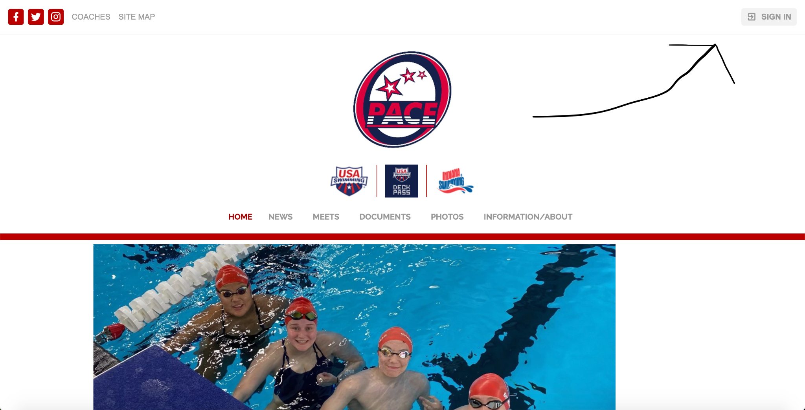

Slide 9
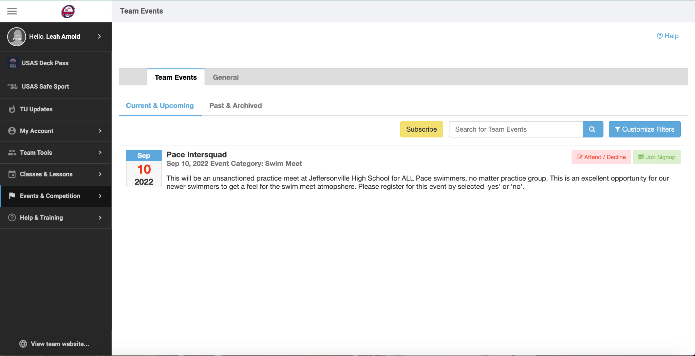
Select the red “Attend/Decline” button on the events page.

Slide 10
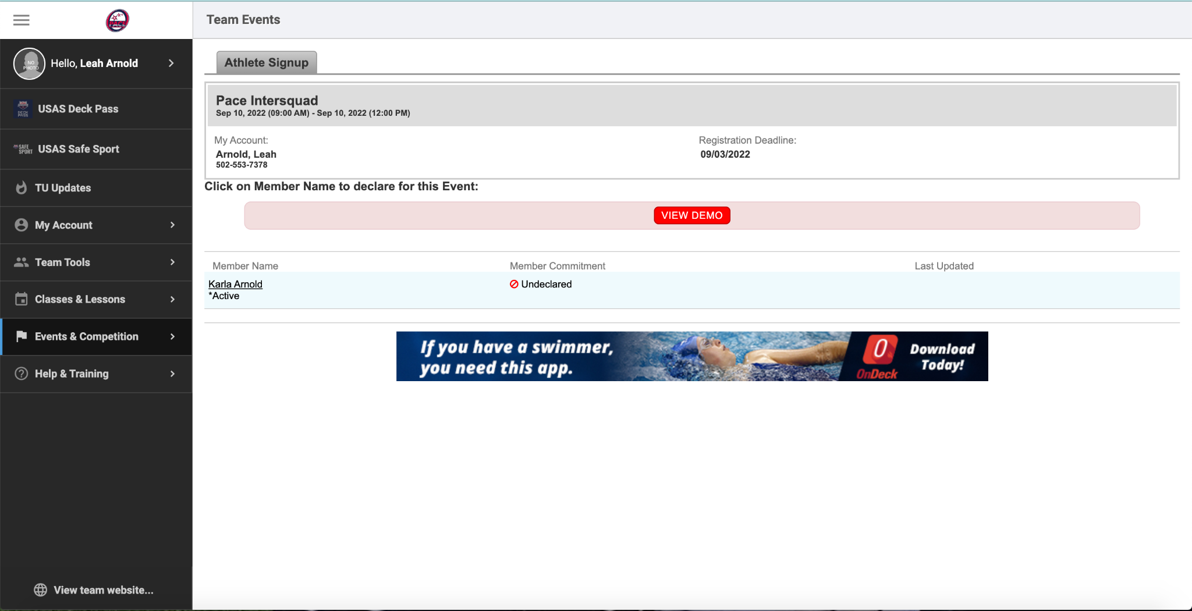
Select the name of the swimmer that will be participating in the event.

Slide 11
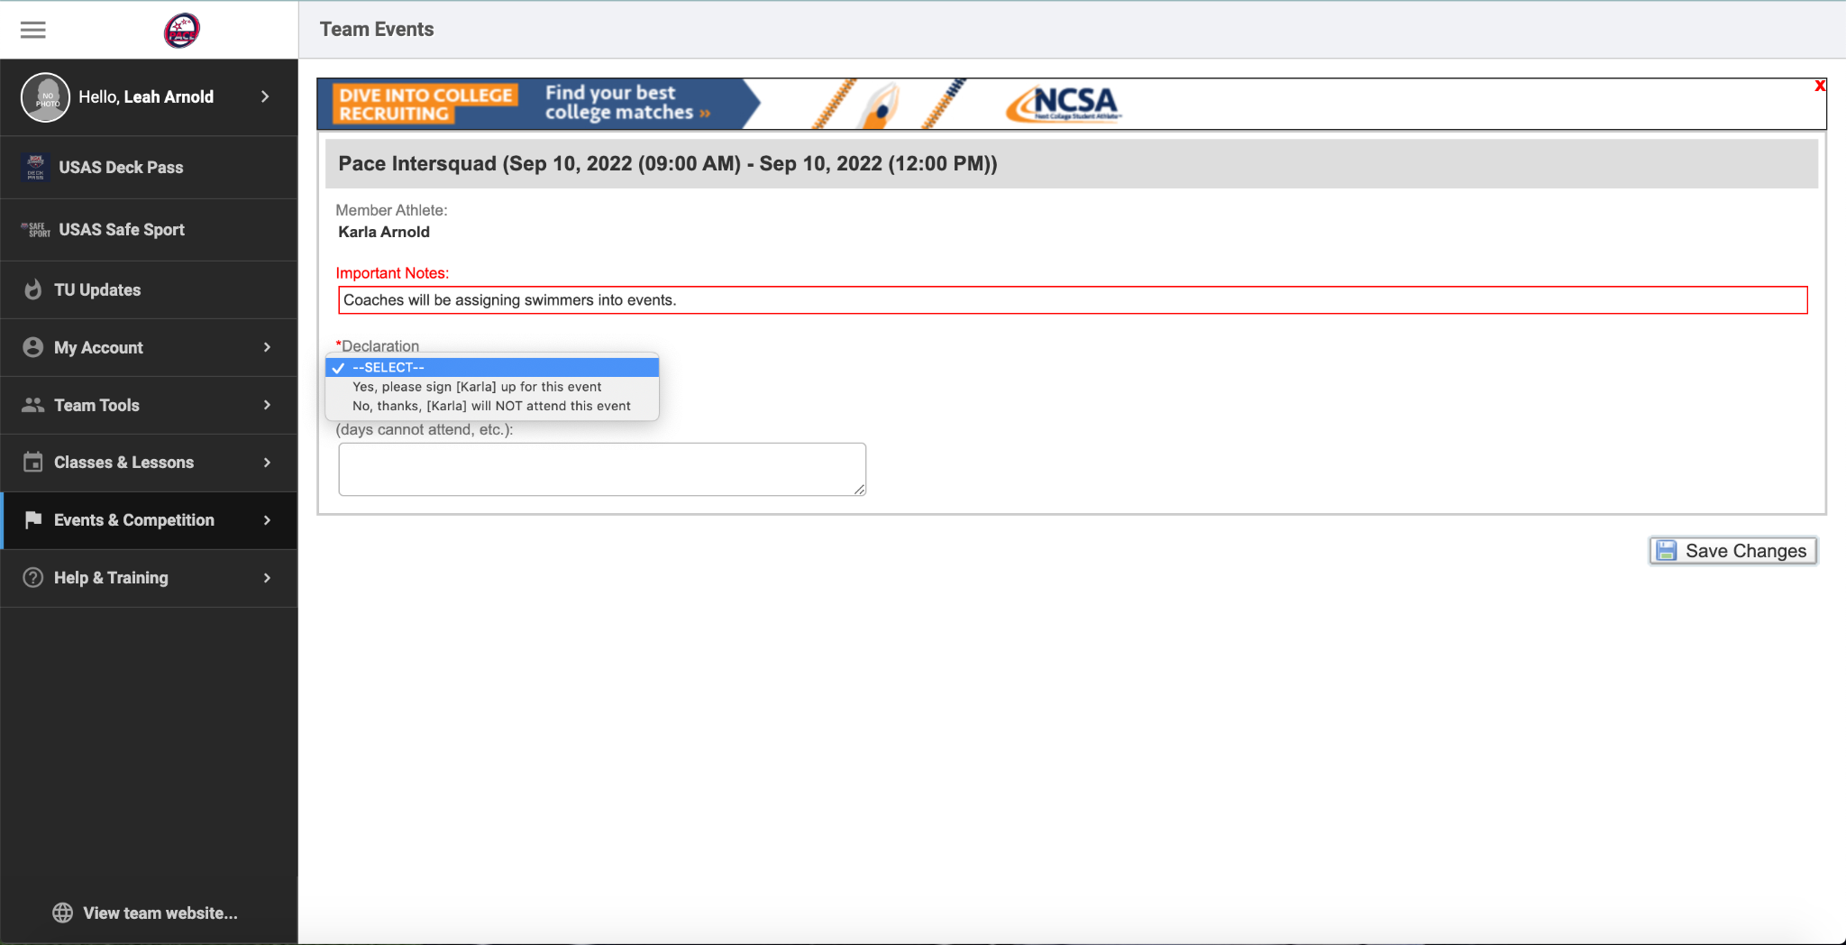
All meets and events will have you declare yes or no.
Our multi-day meets will then have you declare which days and sessions your swimmer plans to attend.
That information can be found in the meet letter on the main event page.

Slide 12
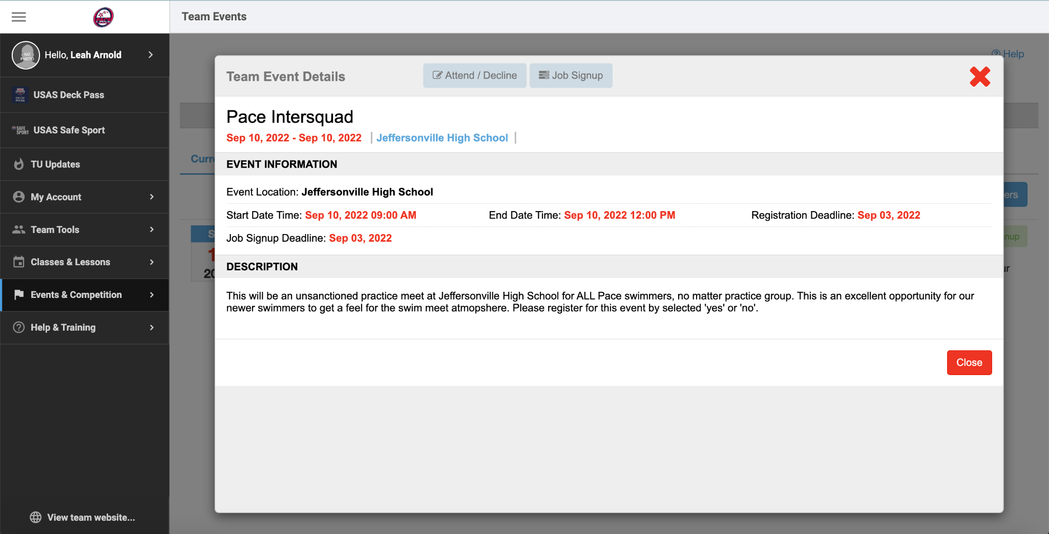
This event does not have files - but files will be found for all other meets by clicking the name of the event. This box appears.

Slide 13
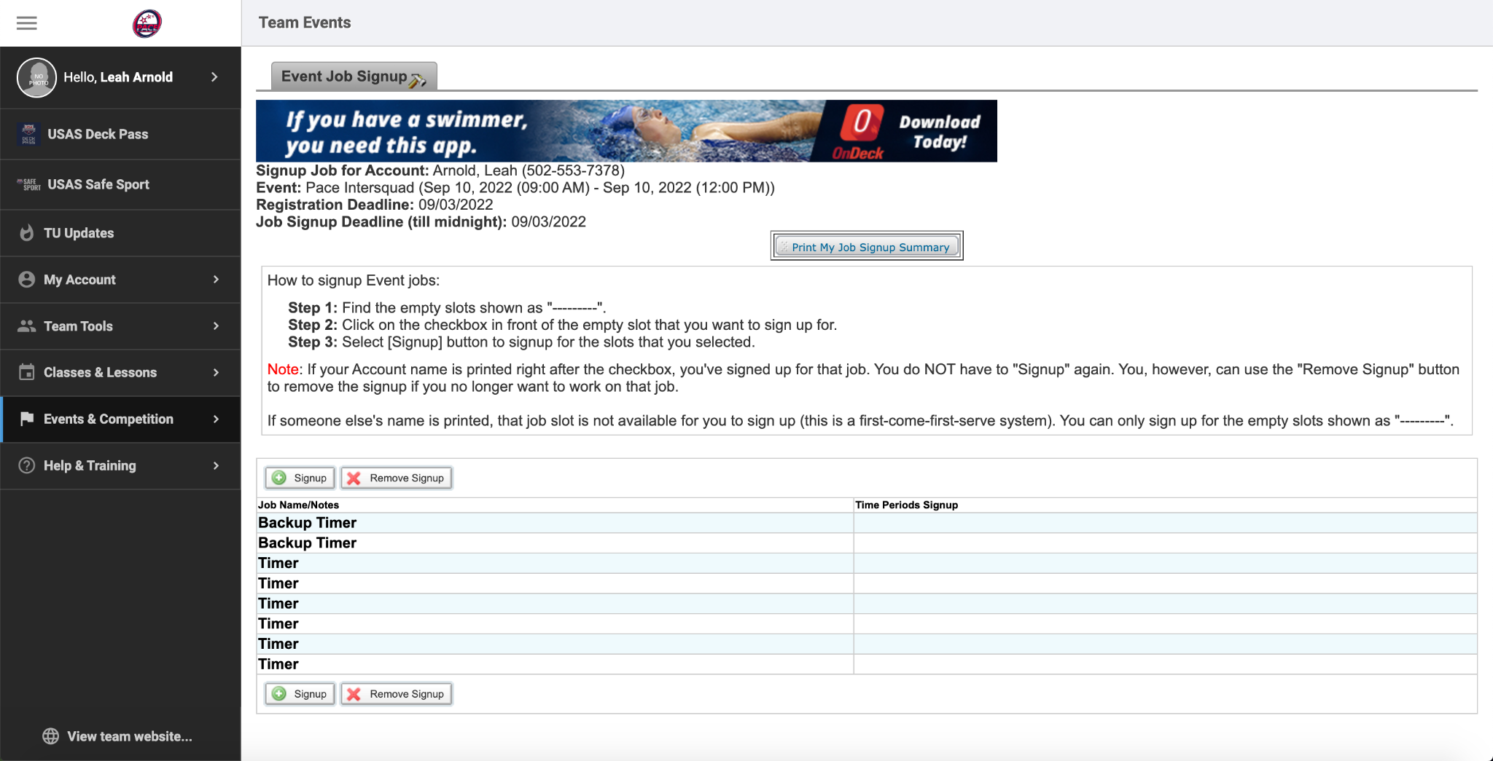
Selecting Job Signups on the previous page allows you to see all the jobs that are required to hold a meet at JHS.
Signup by selecting the signup button and then selecting the job that you’d like.

Slide 14
Billing
All billing is done through Team Unify. When you registered you put a card on file. We will send out a billing statement about a week before you’re billed.
All billing is done on the 1st of the month.
We need at least 30 days notice to pause or cancel billing.
If you email amber@swimpace.org and/or abbey@swimpace.org about pausing billing on September 15th, normal billing will take place on October 1st and then we will pause for November.

Slide 15
Family Volunteer Requirements
We can not function without the support of our parents!
All families are asked to support our team by doing one of the following:
Participating on our Board of Directors
See Abbey if interested
Becoming certified to be an Official
See Todd Ramirez if interested
Volunteering at our home meet
Donating goods for the home meet
Volunteer positions and donations can be signed up for on the Event page of the home meet.
Families that fail to fulfill the volunteer requirement will be charged a $150 fee.

Slide 16
Additional Ways to Support Us!
Periodic fundraisers will occur this season. This is an excellent way to support our team.
SPONSORSHIPS! If you know of a business that would like to support Pace, please contact them! We have a sponsorship letter available!
Shopping at Swimville USA and telling them you’re with Pace
Amazon and Kroger

